Slide 1
Security Hardening – Case Study – Oracle
Oracle database 11.2g
DISA, Release 11
28 April 2017

Slide 2
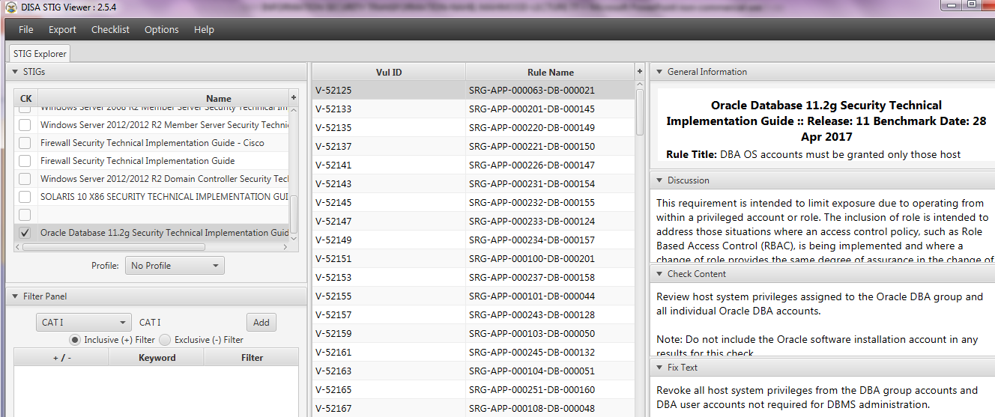
Security Hardening – Case Study – Oracle
STIGVIEWER WINDOW

Slide 3
Security Hardening – Case Study – Oracle
General Information:
Rule Title: The Oracle REMOTE_OS_ROLES parameter must be set to FALSE.
STIG ID: O112-BP-022000
Severity: CAT I

Slide 4
Security Hardening – Case Study – Oracle
Discussion:
Setting REMOTE_OS_ROLES to TRUE allows operating system groups to control Oracle roles. The default value of FALSE causes roles to be identified and managed by the database…

Slide 5
Security Hardening – Case Study – Oracle
Discussion…:
…If REMOTE_OS_ROLES is set to TRUE, a remote user could impersonate another operating system user over a network connection.

Slide 6
Security Hardening – Case Study – Oracle
Check Content:
From SQL*Plus: select value from v$parameter where name = 'remote_os_roles';
If the returned value is not FALSE or not documented in the System Security Plan as required, this is a Finding

Slide 7
Security Hardening – Case Study – Oracle
Fix Text:
Document remote OS roles in the System Security Plan.
If not required, disable use of remote OS roles.
From SQL*Plus: alter system set remote_os_roles = FALSE scope = spfile;

Slide 8
Security Hardening – Case Study – Oracle
Fix Text:
The above SQL*Plus command will set the parameter to take effect at next system startup

Slide 9
Security Hardening – Case Study – Oracle
CCI (Control Correlation Identifier):
CCI: CCI-000366 The org implements the security configuration settings. NIST SP 800-53 :: CM-6 b NIST SP 800-53A :: CM-6.1 (iv) NIST SP 800-53 Revision 4 :: CM-6 b
END

